Slide 1
Junior design - CSE 299
WEEK 6 PRESENTATION
Member 1:
Name : Shad Al Kaiser
Id: 172 1392 042
Member 2 :
Name : Ashraful Kalam Abid
Id : 172 1464 042

Slide 2
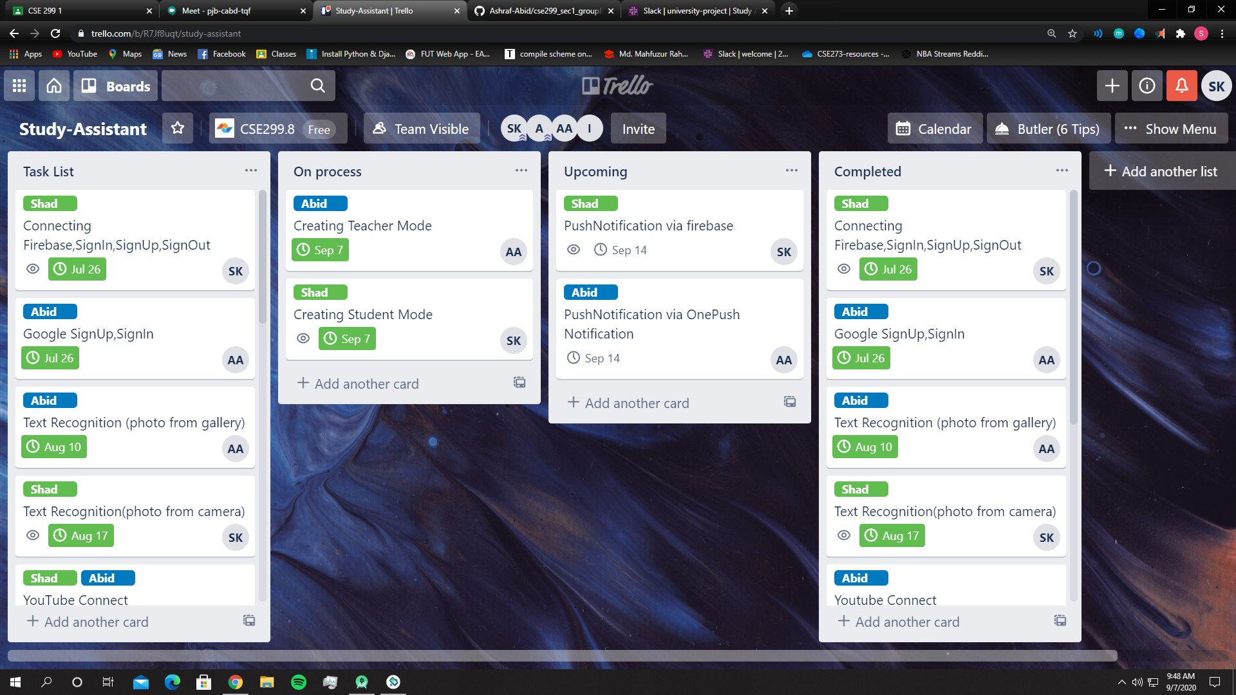
TRELLO BOARD: https://trello.com/b/R7Jf8uqt/study-assistant

Slide 3
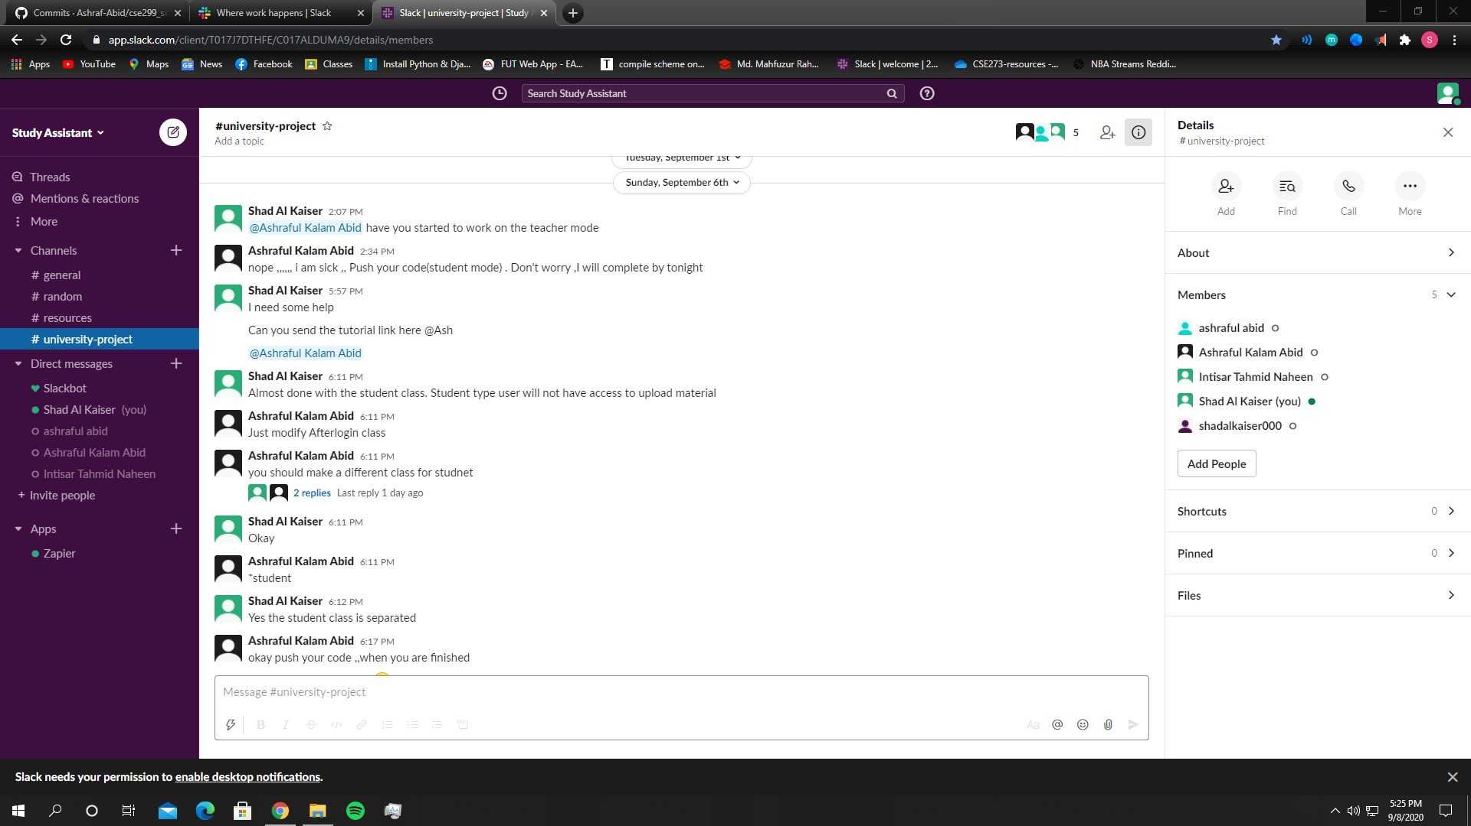
SLACK: https://app.slack.com/client/T017J7DTHFE/C017ALDUMA9/details/members

Slide 4
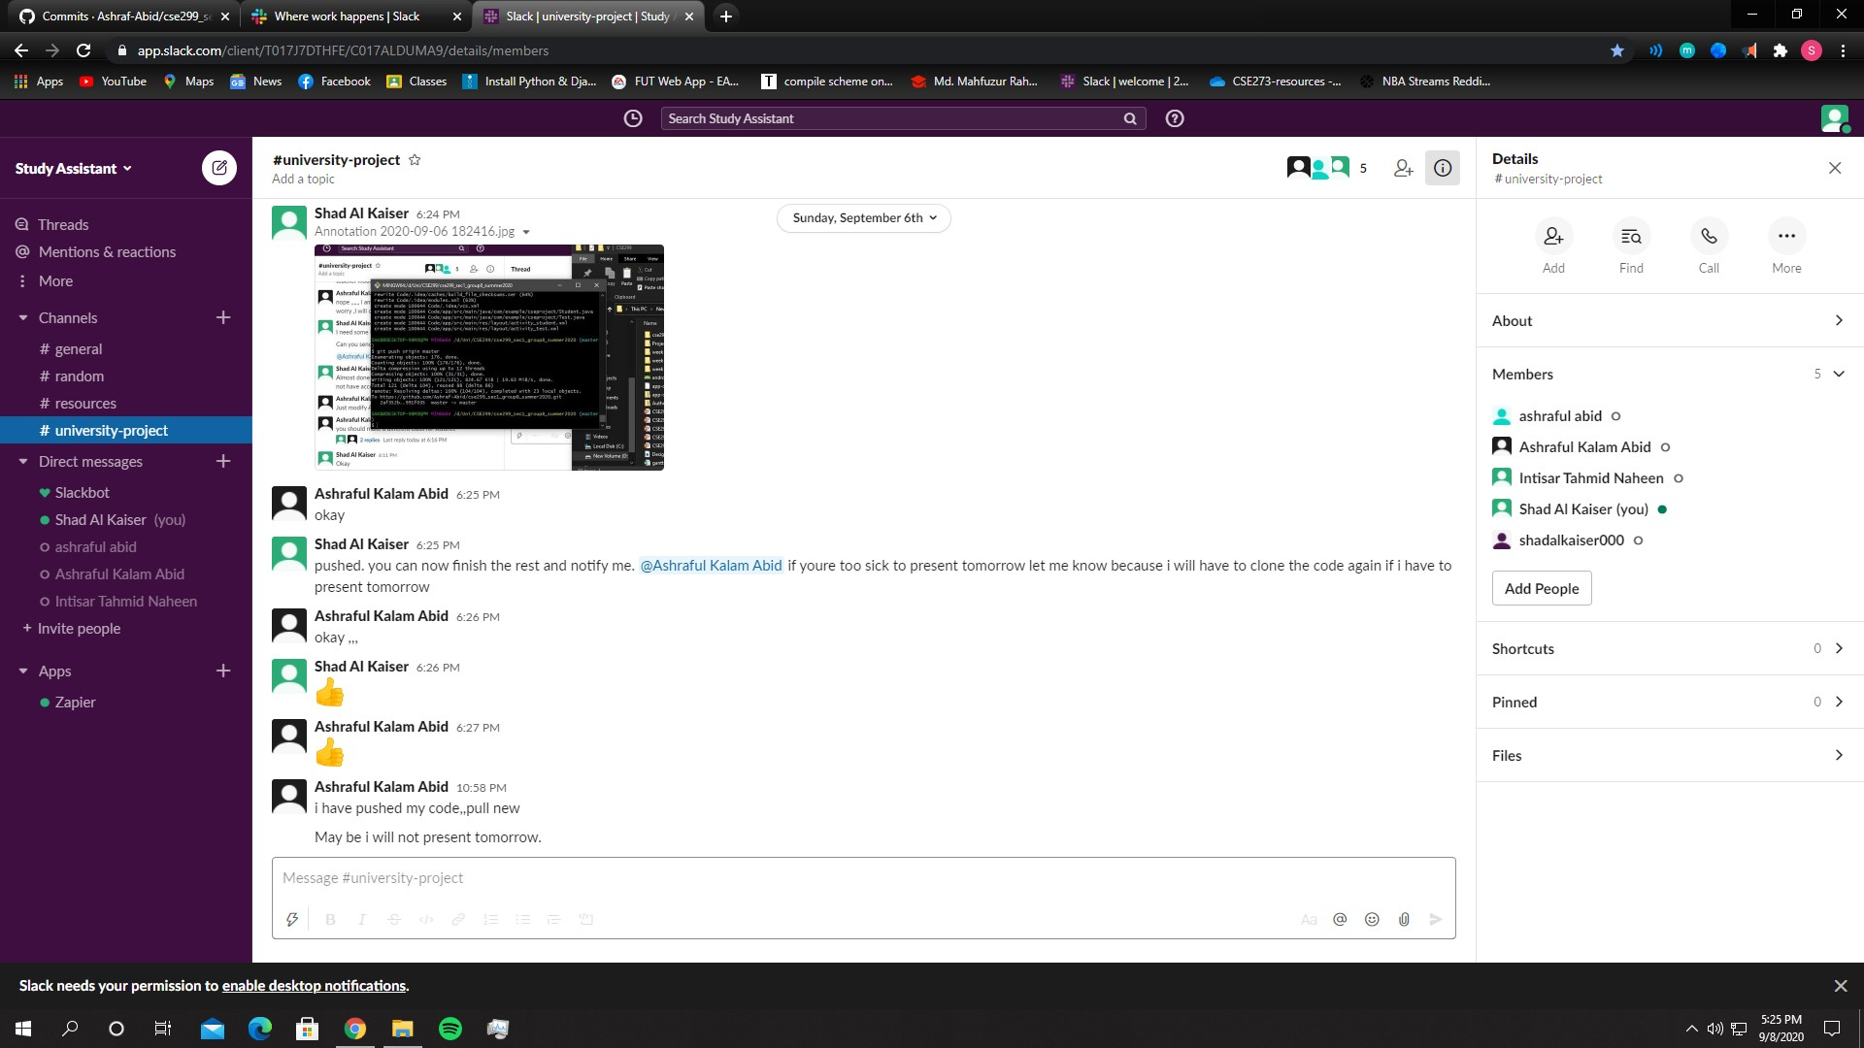

Slide 5
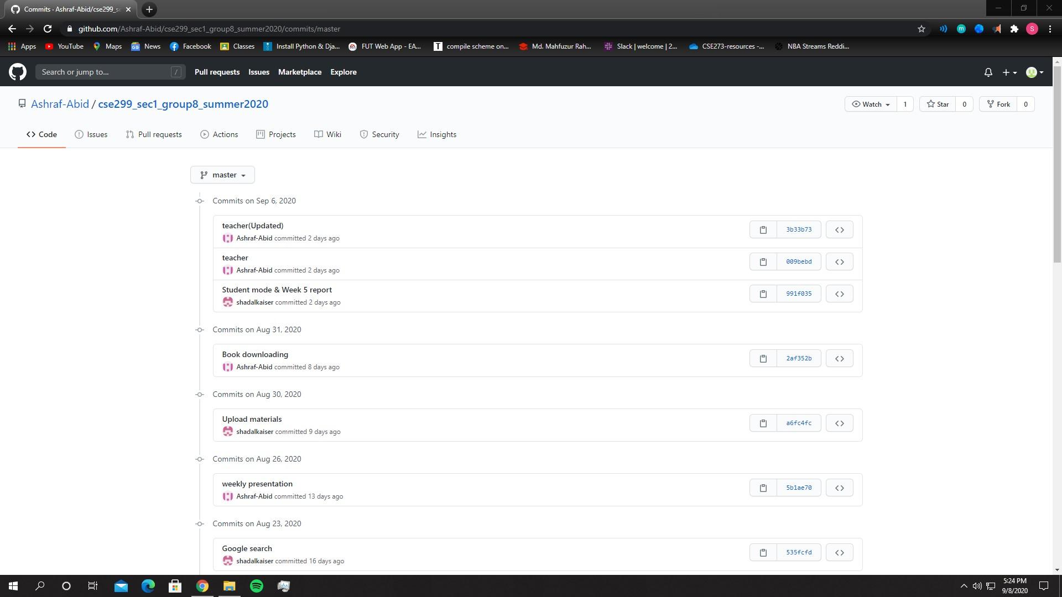
GITHUB repo: https://github.com/Ashraf-Abid/cse299

Slide 6
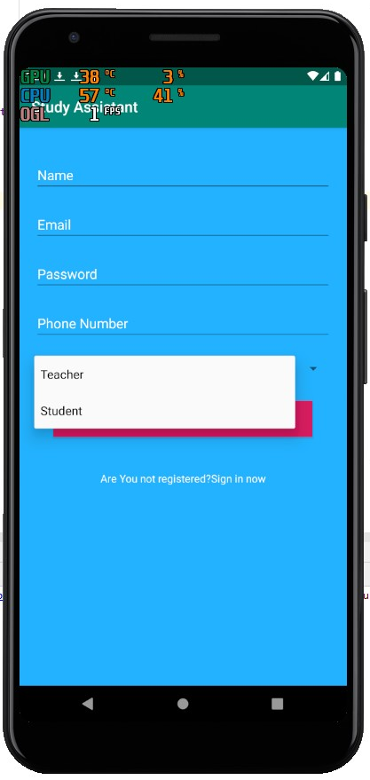
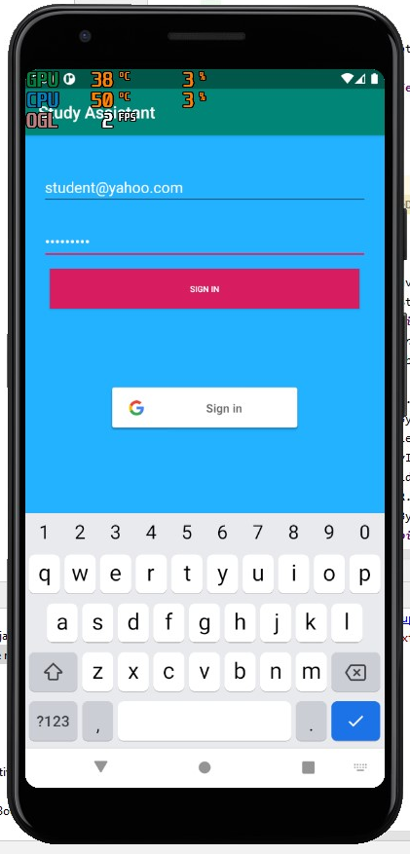
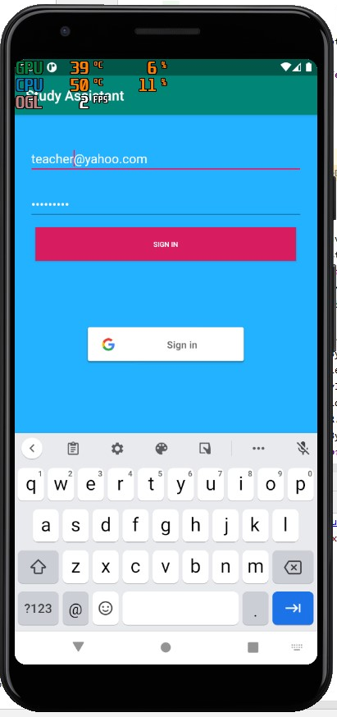
App screenshot:

Slide 7
